Slide 1
AfriTech Electronics Ltd
Precious Akams

Slide 2
Executive Summary
.
.
AfriTech Electronics achieved $57.5M in revenue with 73,586 items sold.​
Over 50% of revenue was lost due to product recalls, especially in Smartwatch and Tablet lines.​
Social media engagement is high, with Instagram and TikTok leading.​
Crisis management metrics highlight slow response and moderate resolution rates.​
Recommendations focus on quality improvement, faster crisis response, and leveraging social channels.​
.
.
.
Total Revenue By Customer Type :

Slide 3
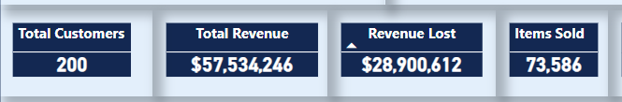
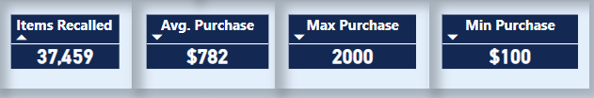
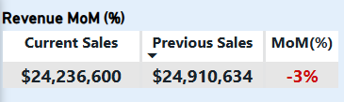
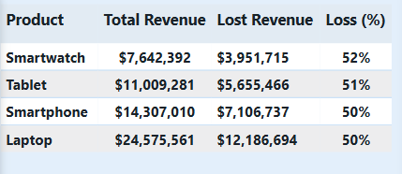
Sales Performance overview
.
Total Revenue: $57,534,246
Items Sold: 73,586
Revenue Lost: 50%
Avg. Purchase Amount: $782;
Max Purchase Amount: $2000;
Min Purchase Amount: $100.
MoM Revenue Growth (2023): -3%
Product-wise Breakdown:
.
Product | Loss (%)
Smartwatch | 52%
Tablet | 51%
Smartphone | 50%
Laptop | 50%
.
.
.
Total Revenue By Customer Type :

Slide 4
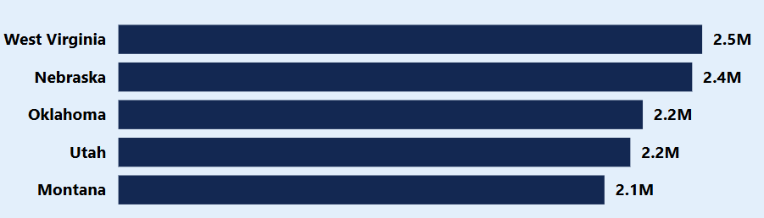
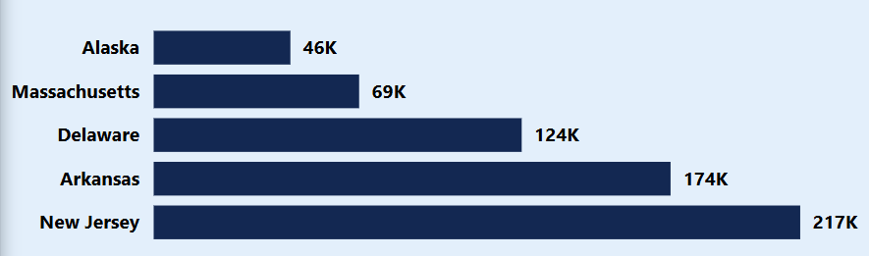
Sales Performance overview
Regions With The Highest Sales Volume:
Regions With The Worst Sales Volume:
.
.
.
Total Revenue By Customer Type :

Slide 5
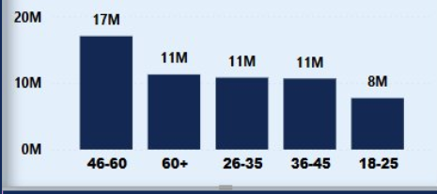
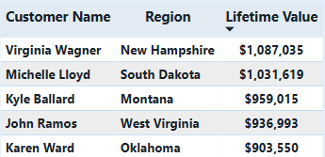
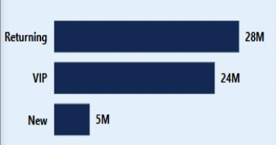
Customer Insights
Total Purchase by Age Group:
Top Value Customers:
.
.
Total Revenue By Customer Type :

Slide 6
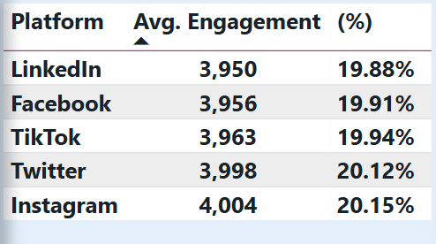
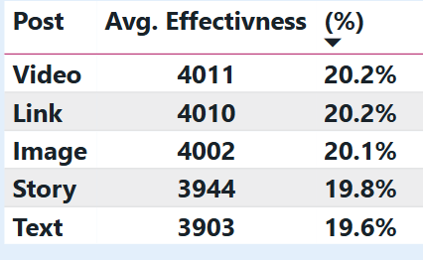
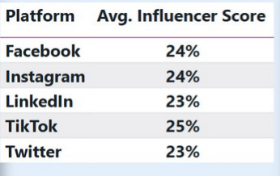
Social Media & Brand Engagement
.
Average Engagement Rate:
  Instagram: 20.15%
  Twitter: 20.12%
  TikTok: 19.94%
  Facebook: 19.91%
  LinkedIn: 19.88%
.
Top Influencers:
Adriana Orr, Robert Jones, James Rose, Nancy Meyer
Influencer Scores:
Post Effectiveness:
Highest engagement (20.2%): Video and link posts
Highest score: Tiktok (25%)
Lowest score: Twitter (23%)

Slide 7
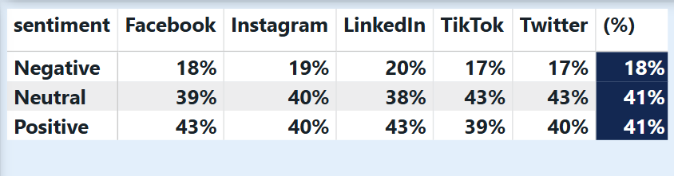
Sentiment Analysis
.
Brand Sentiments by Platform
.
Negative sentiment is highest on LinkedIn (20%)
Neutral sentiment is highest on Tiktok and Twitter (43%)
Positive sentiment is highest on LinkedIn and Facebook (43%)

Slide 8
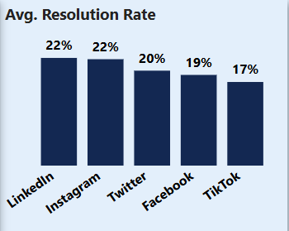
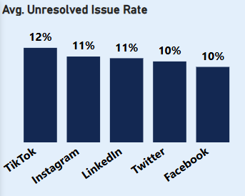
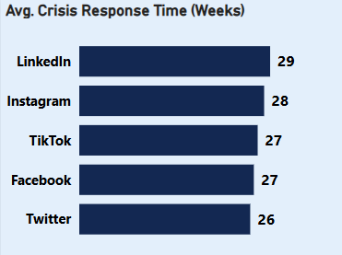
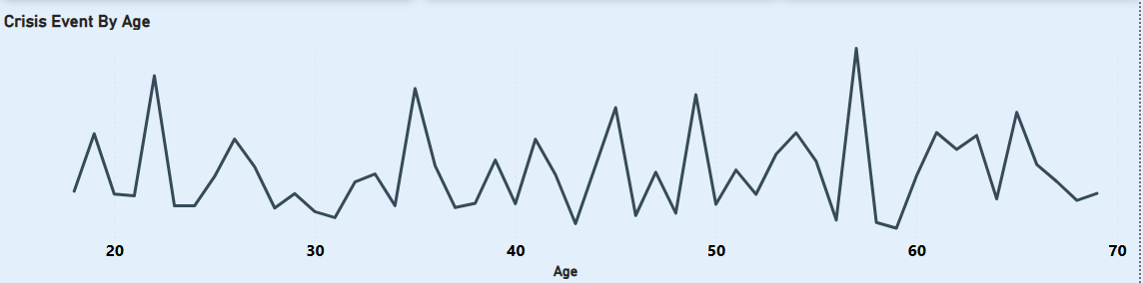
Complaints & Crisis Management
.
Avg. Resolution Rate is 10.2%
Unresolved Issue Rate is 11%
.
.
Avg. Crisis Response Time is 27 Weeks
57 year olds had the highest number of crisis events

Slide 9
Recommendations
.
.
.
Reduce Product Recalls: Invest in QA and supply chain improvements.
Accelerate Crisis Response: Shorten response times and improve resolution rates.
Leverage Social Channels: Focus on Instagram and TikTok for marketing and customer engagement.
Customer Retention: Target high-value and loyal customer segments with tailored offers.
Regional Focus: Increase investment in top-performing regions.

Slide 10
THANK YOU
Precious Akams

